Slide 1
CS 3006 Parallel and Distributed Computing Lecture 4
Danyal Farhat
FAST School of Computing
NUCES Lahore

Slide 2
Network Topologies for Parallel Architectures, Evaluating Static Inter-connections in-terms of Cost, Diameter, Bisection width, and Arc Connectivity

Slide 3
Outline
Buses
Crossbar Network
Multistage Omega Network
8 x 8 Omega network
Shared Memory Interconnection Network (Revisited)
Advantages of Shared Memory Machines
Disadvantages of Shared Memory Machines

Slide 4
Outline (Cont.)
Distributed-Memory SIMD
Distributed-Memory MIMD
Examples
DM-MIMD Routing Mechanism
Linear Arrays
K-d Meshes
Hypercube

Slide 5
Outline (Cont.)
Tree Based Networks and Fat Tree
Evaluating Static Interconnections
Cost
Diameter
Bisection Width
Arc Connectivity
Summary
Exercise
Additional Resources

Slide 6
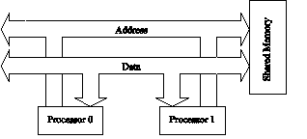
Buses
Simplest and earliest parallel machines used buses
All processors access a common bus for exchanging data
The distance between any two nodes is O(1) in a bus
Bus provides a convenient broadcast media

Slide 7
Buses (Cont.)
The bandwidth of the shared bus is a major bottleneck
Typical bus based machines are limited to dozens of nodes
Sun Enterprise servers and Intel Pentium based shared-bus multiprocessors are examples of such architectures

Slide 8
Crossbar Network
Crossbar network allows any system processor to connect to any other processor or memory unit
A simple way of connection between processors (p) and memory banks (m)
Used in the design of:
High performance small scale multiprocessors
Direct network routers
Large scale indirect networks as fundamental components

Slide 9
Crossbar Network (Cont.)

Slide 10
Crossbar Network (Cont.)
Uses an p × m grid of switches to connect p inputs to m outputs in a non-blocking manner
The cost of a crossbar of p processors grows as O(p x p)
This is generally difficult to scale for large values of p
Examples of machines that employ crossbars include the Sun Ultra HPC 10000 and the Fujitsu VPP500
Crossbars have excellent performance scalability but poor cost scalability
Buses have excellent cost scalability, but poor performance scalability

Slide 11
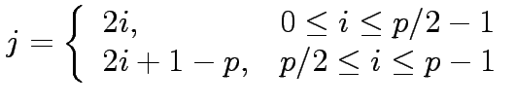
Multistage Omega Network
One of the most commonly used multistage interconnects is the Omega network
This network consists of log p stages, where p is the number of inputs/outputs
At each stage, input i is connected j

Slide 12
Multistage Omega Network (Cont.)
Each stage of the Omega network implements a perfect shuffle as follows:

Slide 13
8 x 8 Omega network
A complete Omega network with the perfect shuffle interconnects and switches can now be illustrated:
An omega network has p/2 × log p switching nodes, and the cost of such a network grows as (p log p)

Slide 14
Multistage Omega Network (Cont.)
Machines like IBM eServer p575 and SGI Altix 4000 use Ω-network
Ω-network is much more interesting for large number of processors
Problem: the switches have to be fast enough, and also the width of the links is important. 16 bit parallel is better than serial links
Multiprocessor vector-processors use instead crossbars (because at most only 32 processors)
Synchronization is usually performed with special communication registers (CPU to CPU); if there is little synchronization shared memory is admitted

Slide 15
Shared Memory Interconnection Network (Revisited)
There are three main network topologies available:
Crossbar (n x n connections - datapath without sharing)
Ω-network (n log n connections - log n switching stages and shared on a path)
Central databus (O(1) connections - n shared)

Slide 16
Advantages of Shared Memory Machines
User-friendly programming environment due to global address space
Data sharing is fast and uniform due to proximity (nearness) of memory to CPUs
Memory coherence is managed by the operating system
Memory Coherence: Multiple processors trying to access the same memory location

Slide 17
Disadvantages of Shared Memory Machines
Performance degradation due to “memory contention” (several processors try to access the same memory location)
Programmer’s responsibility for synchronization constructs (correct access to memory)
Expensive to design shared memory computers with increasing numbers of processors
Adding processors can geometrically increase traffic on the shared memory-CPU path and for cache coherence management
Cache Coherence: Multiple processors trying to access the same cache

Slide 18
Distributed-Memory SIMD
These machines are sometimes also known as processor-array machines
They work in lock-step, i.e. all processors execute the same instruction at the same time (but on different data items); no synchronization is required
A control processor issues the instructions that are to be executed by the processors in the processor array

Slide 19
Distributed-Memory SIMD (Cont.)
GPUs are similar to processor array systems
DM-SIMD are specialized on digital signal and image processing and on certain types of Monte Carlo simulations with virtually no exchange between processors
Monte Carlo Simulation is a mathematical technique that is used to estimate possible outcome of an uncertain event.
Operations that cannot be executed by the processor array or by the control processor are off-loaded to the front-end system
I/O may be through:
the front end system
the processor array
both

Slide 20
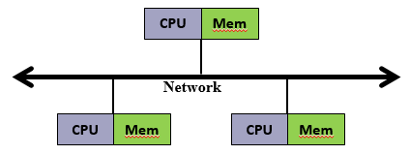
Distributed-Memory MIMD
Processors have their own local memory
No concept of global address space across all processors
Distributed memory systems require a communication network to connect inter-processor memory

Slide 21
Examples
Shared-memory SIMD systems
The Hitachi S3600 series
Distributed-memory SIMD systems
The Alenia Quadrics
The Cambridge Parallel Processing Gamma II
The Digital Equipment Corp. MPP series
The MasPar MP-1
The MasPar MP-2
Shared-memory MIMD systems
The Cray Research Inc. Cray J90-series, T90 series
The Hitachi S3800 series
The HP/Convex C4 series
The Digital Equipment Corp. AlphaServer
The NEC SX-4
The Silicon Graphics Power Challenge
The Tera MTA

Slide 22
Examples (Cont.)
Distributed-memory MIMD systems
The Alex AVX 2
The Avalon A12
The C-DAC PARAM 9000/SS
The Cray Research Inc. T3E
The Fujitsu AP1000
The Fujitsu VPP300 series
The Hitachi SR2201 series
The HP/Convex Exemplar SPP-1200
The IBM 9076 SP2
Distributed-memory MIMD systems
The Intel Paragon XP
The Matsushita ADENART
The Meiko Computing Surface 2
The nCUBE 3
The NEC Cenju-3
The Parallel Computing Industries system
The Parsys TA9000
The Parsytec GC/Power Plus

Slide 23
DM-MIMD Routing Mechanism
Routing mechanism determines the path a message takes through network to reach from source to destination node.
Data and task decomposition have to be dealt explicitly!
Topology and speed of the data paths are crucial and have to be balanced with costs.
Routing can be classified as:
Minimal
Non-minimal
It can also be classified as:
Deterministic routing
Adoptive routing

Slide 24
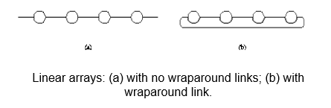
Linear Arrays
In a linear array, each node has two neighbors, one to its left and one to its right.
If the nodes at either end are connected, we refer to it as a 1-D torus or a ring.

Slide 25
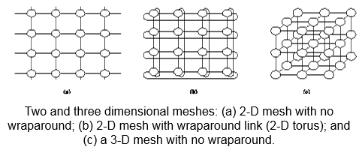
K-d Meshes
A generalization has nodes with 4 neighbors, to the north, south, east, and west.
A further generalization to d dimensions has nodes with 2d neighbors (i.e., 6 neighbors in case of 3d cube).
3d-weather modeling, 3d-structure modeling

Slide 26
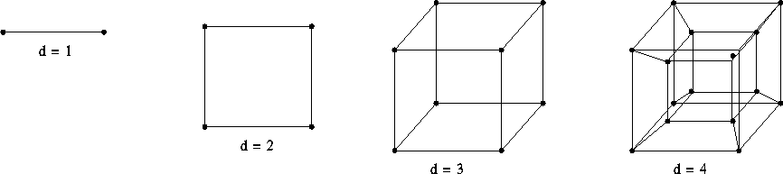
Hypercube
For an hypercube with 2d nodes the number of steps to be taken between any two nodes is at most d (logarithmic grow)
d = log p (dimensions = log(nodes))
The distance between any two nodes is at most log p.
Each node has log p neighbors.

Slide 27
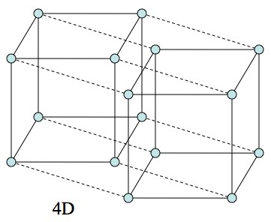
Hypercube (Cont.)
Rule of thumb: “d-dimensional hypercube can be constructed by connecting corresponding nodes of two different (d-1)-dimensional hypercubes”

Slide 28
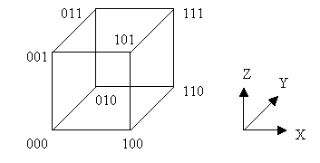
Hypercube (Cont.)
The processors are numbered with 3-bit binary numbers which represent the X-Y-Z coordinates
The distance between two nodes is given by the number of bit positions at which the two nodes differ.

Slide 29
Tree Based Networks
A tree network is one in which there is one path between any pair of nodes
Linear arrays and star-connected networks are special cases of tree-based networks
In static tree network, each node represent a processing element
In dynamic tree network, leaf nodes represent processing element while internal nodes are switching elements

Slide 30
Tree Based Networks (Cont.)
The source node sends the message up the tree until it reaches the node at the root of the smallest subtree containing both the source and destination nodes.
Trees can be laid out in 2D with no wire crossings. This is an attractive property of trees.
The distance between any two nodes is no more than 2logp.

Slide 31
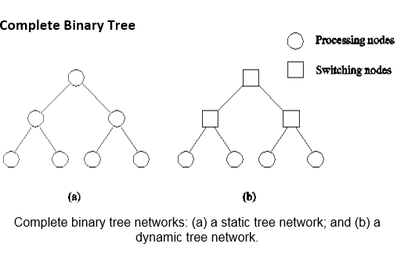
Tree Based Networks (Cont.)

Slide 32
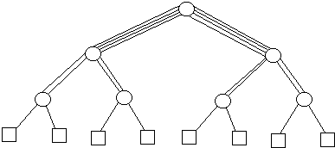
Fat Tree
Another topology is the “fat tree”
In a tree, a node can speak to another node passing through the root so we have higher traffic at the root node.
Fat tree amends this providing more bandwidth (with multiple connections) in the higher levels of the tree
N-ary fat tree is when the levels towards the root have N times the number of connections in the level below it

Slide 33
Evaluating Static Interconnections
The parameters to evaluate a static interconnection:
Cost: Usually depends on number of links for communication. E.g., cost for linear array is p-1.
Lower values are favorable
Diameter: The shortest distance between the farthest two nodes in the network. The diameter of a linear array is p − 1.
Lower values are favorable
Bisection Width: The minimum number of wires you must cut to divide the network into two equal parts. The bisection width of a linear array is 1.
Higher values are favorable

Slide 34
Evaluating Static Interconnections (Cont.)
Arc-connectivity: The minimum number of arcs or links that must be removed from the network, to break the network into two disconnected networks
Higher value are desirable
It is minimum number of the links that must be cut to separate the single node from the network
Higher values means, that incase of link failure there are multiple other routes to the node.
Arc-connectivity of linear array is 1 and 2 for ring.

Slide 35
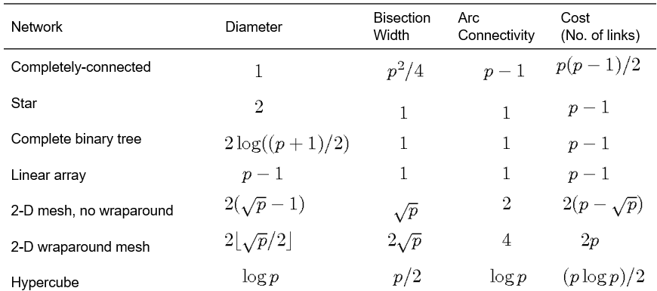
Evaluating Static Interconnections (Cont.)

Slide 36
Exercise
Draw a 4 x 4 Omega network (4 processes and 4 mem modules) and explain how P3 will access M2.
What will be the cost of this network?
How many switching nodes will be required for this network?

Slide 37
Summary
Bus
Simplest network topology for processor to processor and processor to memory communication
Excellent cost scalability but poor performance scalability
Crossbar Network
A p × m grid of switches to connect p inputs to m outputs in a non-blocking manner
Excellent performance scalability but poor cost scalability
Multistage Omega Network
Most commonly used multistage interconnects topology
log p stages, input to output decided by perfect shuffle
Example: 8 x 8 Omega network

Slide 38
Summary (Cont.)
Shared Memory Interconnection Network (Revisited)
Connections available for bus, crossbar and omega network topology
Advantages of Shared Memory Machines
Global address space, data sharing is fast and uniform, memory coherence managed by operating system
Disadvantages of Shared Memory Machines
Performance degradation due to memory contention, and cache contention
Expensive shared memory computer design in case of large number of processors
Distributed-Memory SIMD
Processor array machines, processors execute same instruction on different data sets, control processor issues instruction

Slide 39
Summary (Cont.)
Distributed-Memory MIMD
Local associated memory, no global address space, communication network is required for processor to processor and processor to memory communication
Examples
DM-MIMD Routing Mechanism
Determines the path from source to destination, data and task decomposition, minimal and non-minimal, deterministic and adaptive routing
Linear Arrays
K-d Meshes

Slide 40
Summary (Cont.)
Hypercube
Each node has log p neighbors
Tree Based Networks
In static tree network, each node represent a processing element
In dynamic tree network, leaf nodes represent processing element while internal nodes are switching elements
Fat Tree
More bandwidth (with multiple connections) in the higher levels of the tree

Slide 41
Summary (Cont.)
Evaluating Static Interconnections
Cost - Depends on number of links for communication
Diameter - Shortest distance between two most distant nodes
Bisection Width - Minimum number of wires you must cut to divide the network into two equal parts
Arc Connectivity - Minimum number of links that must be removed from the network, to break the network into two disconnected networks
Exercise
4 x 4 Omega Network

Slide 42
Additional Resources
Book: Introduction to Parallel Computing by Ananth Grama and Anshul Gupta
Chapter 2: Parallel Programming Platforms
Section 2.4.3: Network Topologies
Section 2.6: Routing Mechanisms for Interconnection Networks

Slide 43
Questions?

